Slide 1
Presentation Skills
Top 5 Ways to Deliver an Amazing Presentation

Slide 2
Top 5 Ways to Deliver an Amazing Presentation
Become a more confident speaker
Show credibility
Structure your pres-n
Motivate your audience
Advance in your career

Slide 3
Agenda
Opening and Closing
The Content
Your Confidence
Working with the Audience
Body Language

Slide 4

I. Opening & Closing

Slide 5
II. The Content
What AU needs to know (needs, desires, problems)
What will happen to them
Evidence and examples
Most important pres-n tool
The rule of three
What –Why – How
Edit

Slide 6


Slide 7

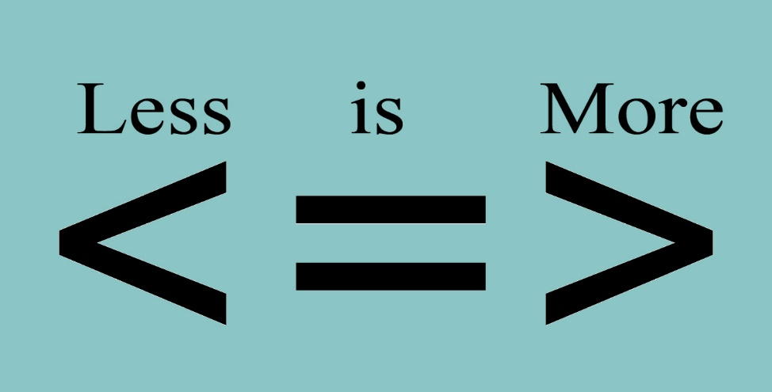




Slide 8
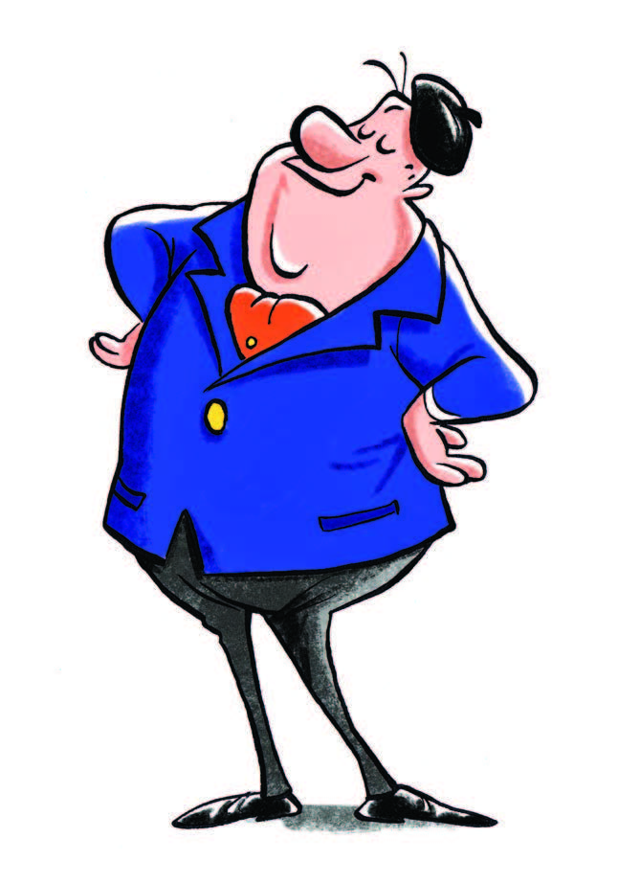
III. Your Confidence
Winning speaking style to convey you are
In charge
Credible
Confident
=> Practice Your Delivery

Slide 9

Dress Rehearsal
New audience
New location
New content
Important
Three “p”s rule

Slide 10
IV. Working with the Audience
Audience = Strategic partner
Audience = reason why you are in the room
Audience wants to
-> Gain new skills
-> Insights
-> General education

Slide 11



Audience types

Slide 12
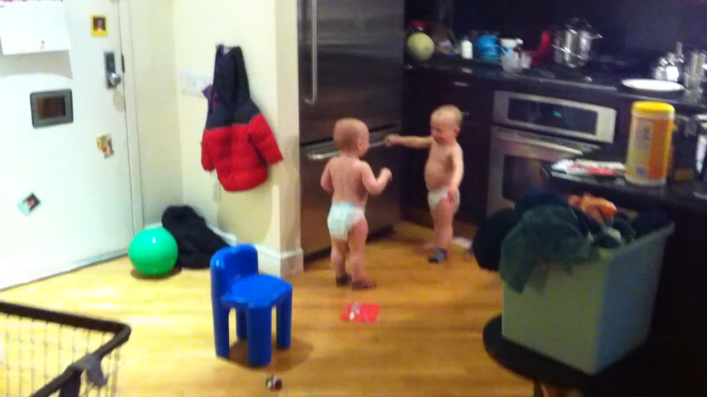
V. Body Language

Slide 13

Posture
Professional & polished
Head held high
Hip-distance apart stance

Slide 14

Gestures & Movement
Help audience understand what you are saying
Open-handed
Avoid crossing middle line of your body
Pointing
Bent-elbow-robot-arms stance
Pizza-pie gesticulating
Rubbing neck, ears
Gym-teacher-hands-on-hips stance

Slide 15

Eye Contact
~ 5 seconds /practice
Builds connection and rapport
Gives you feedback
Connect with people, not regions of the room

Slide 16

Facial Expressions
Normal face expression
Exaggerate for larger groups
Genuine smile

Slide 17

Dress
Finishing touch
Professional outfit
Sends message to audience
First impression

Slide 18



Inna Moldovanu
People Development Trainer
Ina.moldovanu@endava.com
en_imoldovanu

